Slide 1

Machine Learning
Logistic Regression
Pramote Kuacharoen

Slide 2

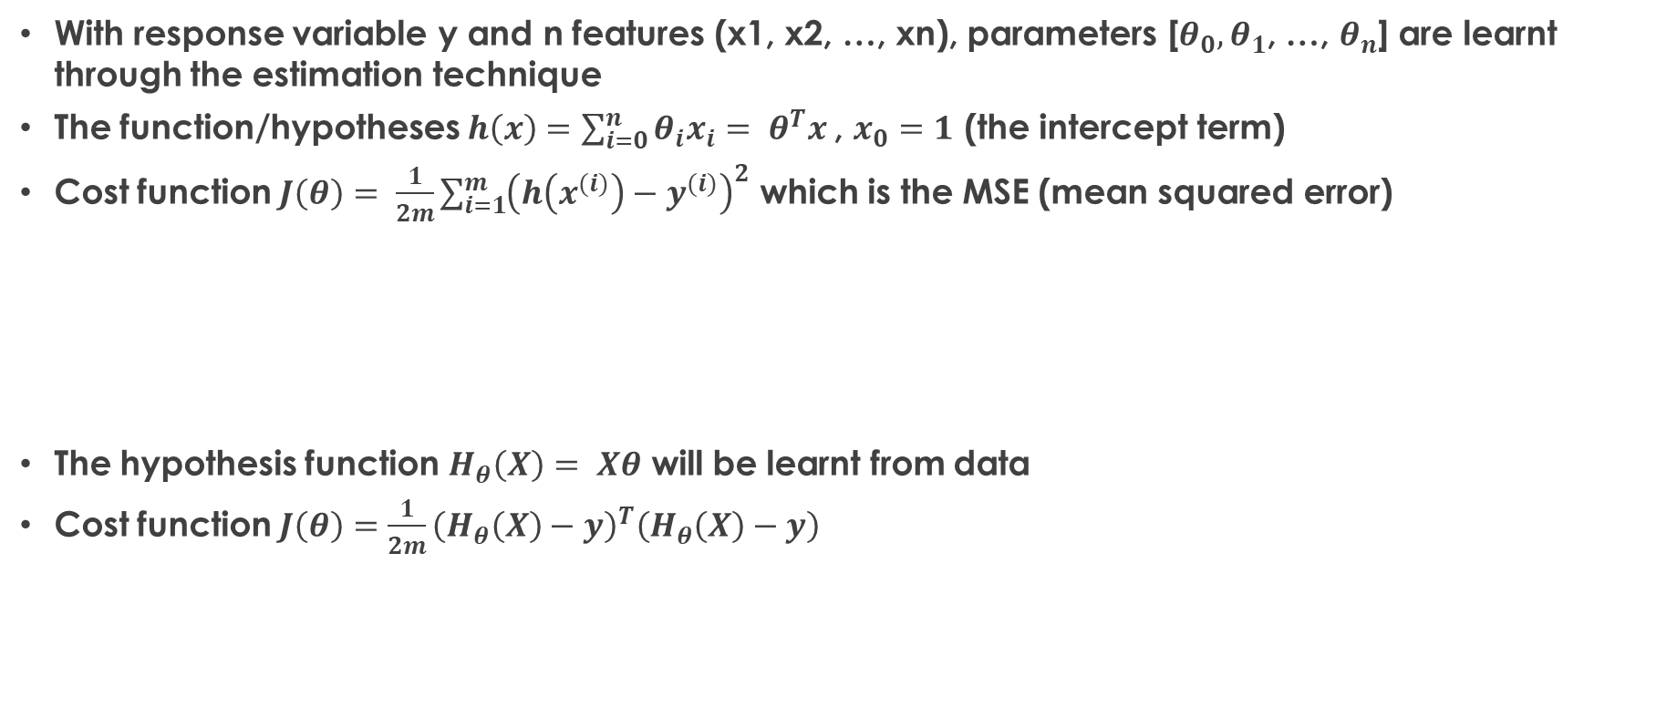


Regression Model Representation
With response variable y and n features (x1, x2, …, xn), parameters [$θ_{0},θ_{1}$, …, $θ_{n}$] are learnt through the estimation technique
The function/hypotheses $h\left(x\right)=\sum_{i=0}^{n}{θ_{i}x_{i}= θ^{T}x}$, $x_{0}=1$ (the intercept term)
Cost function $J\left(θ\right)= \frac{1}{2m}\sum_{i=1}^{m}{{\left(h\left(x^{(i)}\right)−y^{(i)}\right)}^{2}}$ which is the MSE (mean squared error)
The hypothesis function $H_{θ}\left(X\right)= Xθ$ will be learnt from data
Cost function $J\left(θ\right)=\frac{1}{2m}{\left(H_{θ}\left(X\right)−y\right)}^{T}\left(H_{θ}\left(X\right)−y\right)$
$$θ= \left[\begin{matrix}θ_{0} \\ ⋮ \\ θ_{n}\end{matrix}\right]$$
$$X= \left[\begin{matrix}{\left(x^{(1)}\right)}^{T} \\ ⋮ \\ {\left(x^{(m)}\right)}^{T}\end{matrix}\right]$$
$$y= \left[\begin{matrix}y^{(1)} \\ ⋮ \\ y^{(m)}\end{matrix}\right]$$

Slide 3
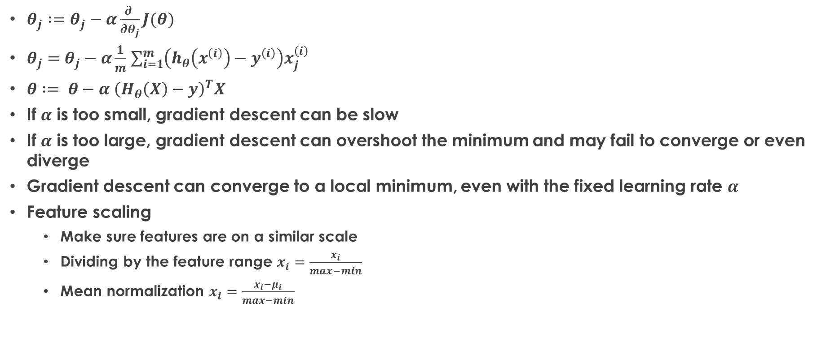
Gradient Descent Algorithm
$θ_{j} :=θ_{j}−α\frac{∂ }{∂θ_{j}}J(θ)$
$θ_{j}=θ_{j}−α\frac{1}{m}$ $\sum_{i=1}^{m}{\left(h_{θ}\left(x^{\left(i\right)}\right)−y^{\left(i\right)}\right)x_{j}^{\left(i\right)}}$
$θ := θ−α {\left(H_{θ}\left(X\right)−y\right)}^{T}X$
If $α$ is too small, gradient descent can be slow
If $α$ is too large, gradient descent can overshoot the minimum and may fail to converge or even diverge
Gradient descent can converge to a local minimum, even with the fixed learning rate $α$
Feature scaling
Make sure features are on a similar scale
Dividing by the feature range $x_{i}=\frac{x_{i}}{max−min}$
Mean normalization $x_{i}=\frac{x_{i}−μ_{i}}{max−min}$

Slide 4


Classification
Email: spam/not spam
Online transactions: fraudulent (yes/no)
Tumor: malignant/benign
$y ∈ \left\{0, 1\right\}$
$h_{θ}(x)$ can be > 1 or < 0
Logistic regression ${0 ≤h}_{θ}\left(x\right)≤1$
1(Y)
Malignant
0(N)
Tumor Size
Threshold classifier output $h_{θ}(x)$ at 0.5
If $h_{θ}(x)≥0.5$, predict y = 1
If $h_{θ}\left(x\right)<0.5$, predict y = 0

Slide 5
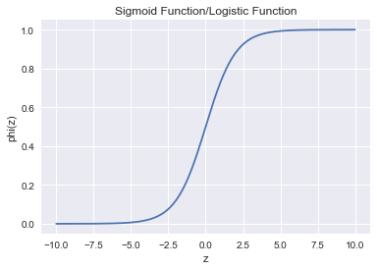
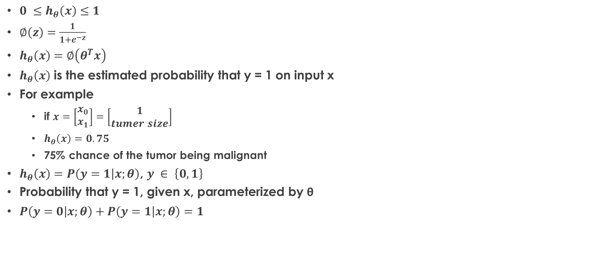

Logistic Regression Model
$$∅\left(z\right)=\frac{1}{1+e^{−z}}$$
${0 ≤h}_{θ}\left(x\right)≤1$
$∅\left(z\right)=\frac{1}{1+e^{−z}}$
$h_{θ}\left(x\right)=∅\left(θ^{T}x\right)$
$h_{θ}\left(x\right)$ is the estimated probability that y = 1 on input x
For example
if $x=\left[\begin{matrix}x_{0} \\ x_{1}\end{matrix}\right]=\left[\begin{matrix}1 \\ tumer size\end{matrix}\right]$
$h_{θ}\left(x\right)=0.75$
75% chance of the tumor being malignant
$h_{θ}\left(x\right)=P\left(y=1 | x;θ\right)$, $y ∈ \left\{0, 1\right\}$
Probability that y = 1, given x, parameterized by θ
$P\left(y=0 | x;θ\right)+P\left(y=1 | x;θ\right)=1$

Slide 6


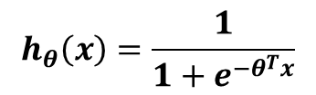


Logistic Regression Model
$$θ= \left[\begin{matrix}θ_{0} \\ ⋮ \\ θ_{n}\end{matrix}\right]$$
$$x= \left[\begin{matrix}x_{0} \\ ⋮ \\ x_{n}\end{matrix}\right]$$
$$X= \left[\begin{matrix}{\left(x^{(1)}\right)}^{T} \\ ⋮ \\ {\left(x^{(m)}\right)}^{T}\end{matrix}\right]$$
$$y= \left[\begin{matrix}y^{(1)} \\ ⋮ \\ y^{(m)}\end{matrix}\right]$$
$$h_{θ}\left(x\right)=\frac{1}{1+e^{−θ^{T}x}}$$

Slide 7
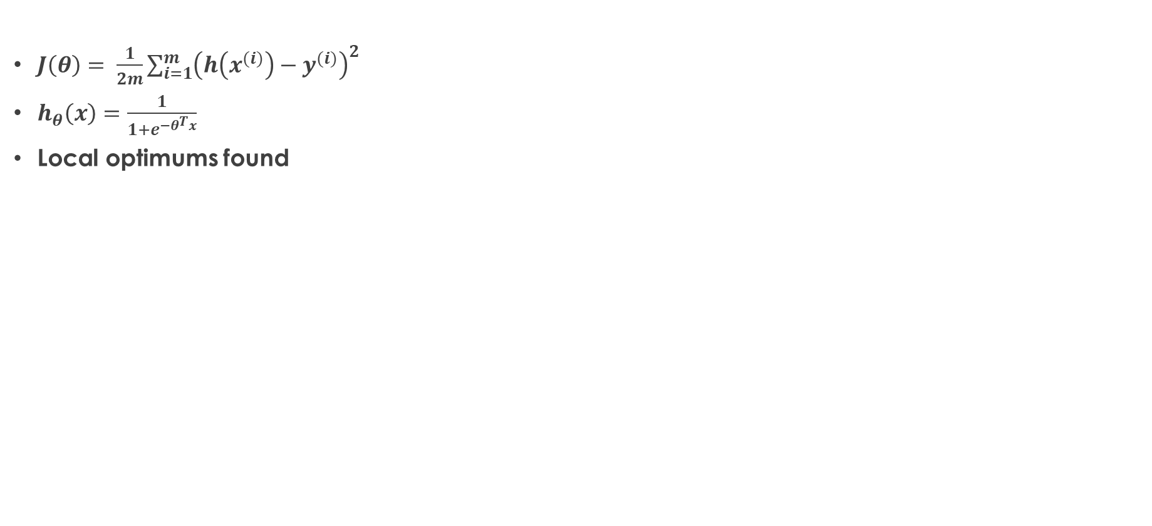
Cost Function
$J\left(θ\right)= \frac{1}{2m}\sum_{i=1}^{m}{{\left(h\left(x^{(i)}\right)−y^{(i)}\right)}^{2}}$
$h_{θ}\left(x\right)=\frac{1}{1+e^{−θ^{T}x}}$
Local optimums found
convex
non-convex
J(θ)
J(θ)
θ
θ

Slide 8
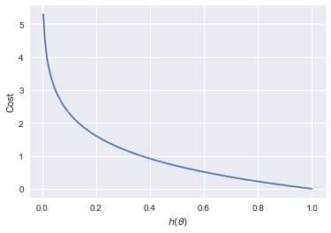

Logistic Regression Cost Function
$Cost\left(h_{θ}\left(x\right), y\right)= \left\{\begin{matrix}−log\left(h_{θ}\left(x\right)\right) \\ −log(1−h_{θ}\left(x\right))\end{matrix}\begin{matrix}if y=1 \\ if y=0\end{matrix}\right.$
Cost = 0 if y = 1 $h_{θ}\left(x\right)=1$
Cost → ∞ as $h_{θ}\left(x\right)→0$
If $h_{θ}\left(x\right)=0$ (predict $P\left(y=1 | x;θ\right)=0$), but y=1, we will penalize learning algorithm by a very large cost
If y =1

Slide 9
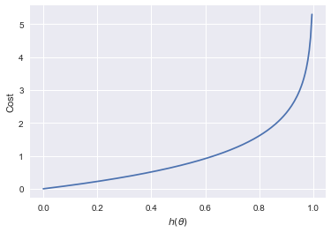
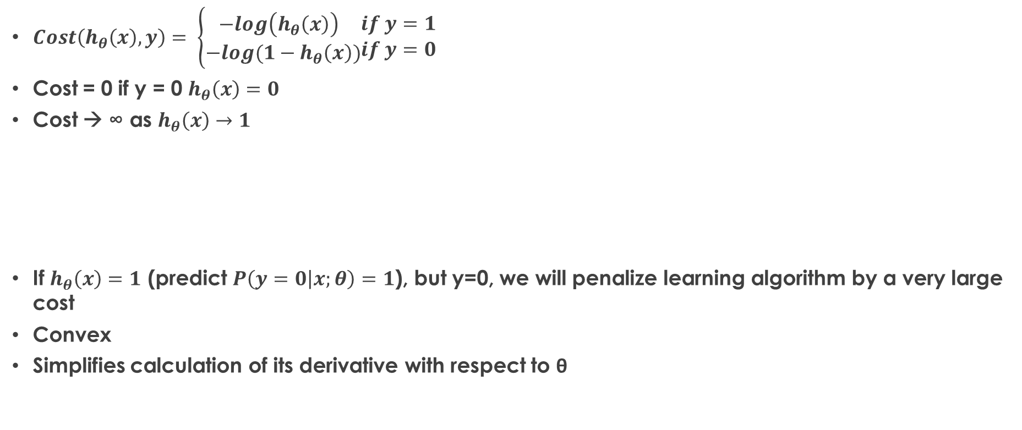
Logistic Regression Cost Function
$Cost\left(h_{θ}\left(x\right), y\right)= \left\{\begin{matrix}−log\left(h_{θ}\left(x\right)\right) \\ −log(1−h_{θ}\left(x\right))\end{matrix}\begin{matrix}if y=1 \\ if y=0\end{matrix}\right.$
Cost = 0 if y = 0 $h_{θ}\left(x\right)=0$
Cost → ∞ as $h_{θ}\left(x\right)→1$
If $h_{θ}\left(x\right)=1$ (predict $P\left(y=0 | x;θ\right)=1$), but y=0, we will penalize learning algorithm by a very large cost
Convex
Simplifies calculation of its derivative with respect to θ
If y =0

Slide 10
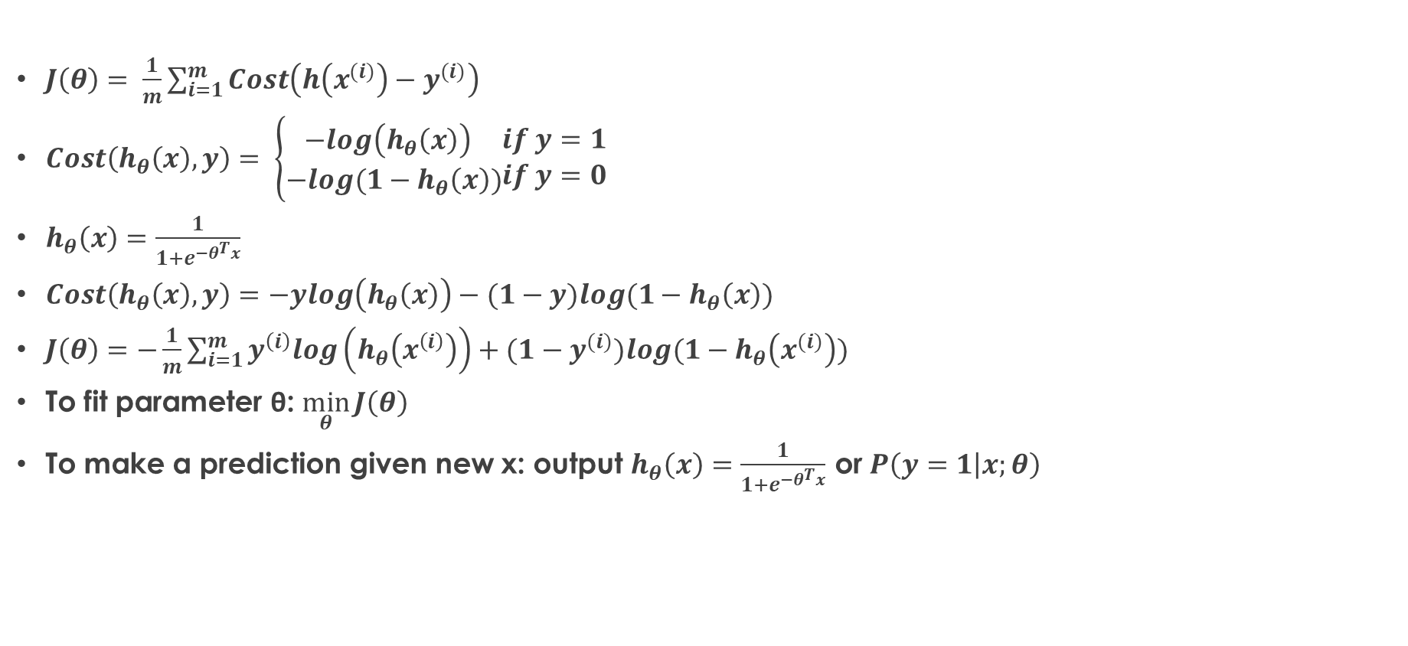
Logistic Regression Cost Function
$J\left(θ\right)= \frac{1}{m}\sum_{i=1}^{m}{Cost\left(h\left(x^{(i)}\right)−y^{(i)}\right)}$
$Cost\left(h_{θ}\left(x\right), y\right)= \left\{\begin{matrix}−log\left(h_{θ}\left(x\right)\right) \\ −log(1−h_{θ}\left(x\right))\end{matrix}\begin{matrix}if y=1 \\ if y=0\end{matrix}\right.$
$h_{θ}\left(x\right)=\frac{1}{1+e^{−θ^{T}x}}$
$Cost\left(h_{θ}\left(x\right), y\right)=−ylog\left(h_{θ}\left(x\right)\right)−(1−y)log(1−h_{θ}\left(x\right))$
$J\left(θ\right)=−\frac{1}{m}\sum_{i=1}^{m}{y^{\left(i\right)}log\left(h_{θ}\left(x^{\left(i\right)}\right)\right)+(1−y^{(i)})log(1−h_{θ}\left(x^{(i)}\right))}$
To fit parameter θ: $\min_{θ}{J\left(θ\right)}$
To make a prediction given new x: output $h_{θ}\left(x\right)=\frac{1}{1+e^{−θ^{T}x}}$ or $P\left(y=1 | x;θ\right)$

Slide 11
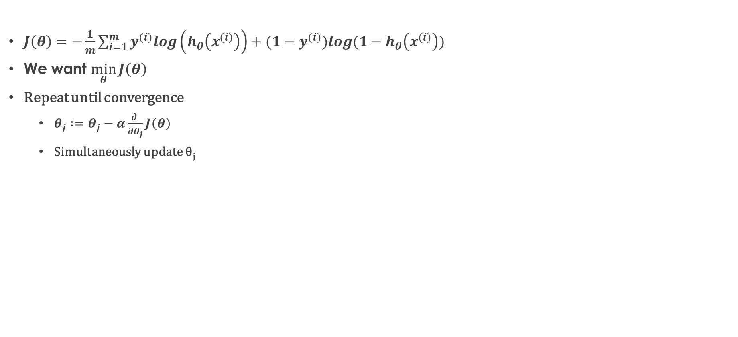
Gradient Descent
$J\left(θ\right)=−\frac{1}{m}\sum_{i=1}^{m}{y^{(i)}log\left(h_{θ}\left(x^{(i)}\right)\right)+(1−y^{(i)})log(1−h_{θ}\left(x^{(i)}\right))}$
We want $\min_{θ}{J\left(θ\right)}$
Repeat until convergence
$θ_{j} :=θ_{j}−α\frac{∂ }{∂θ_{j}}J\left(θ\right)$
Simultaneously update θ_{j}

Slide 12
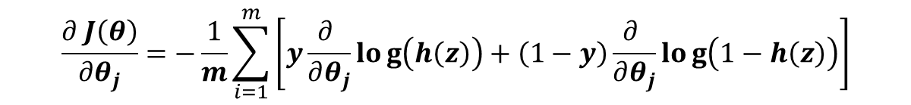
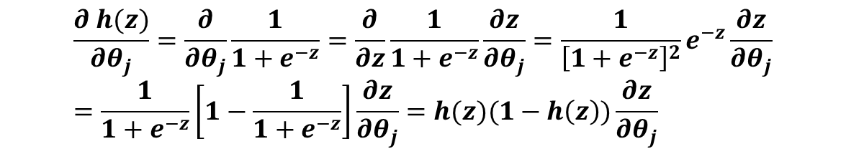
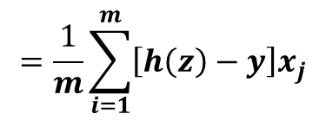
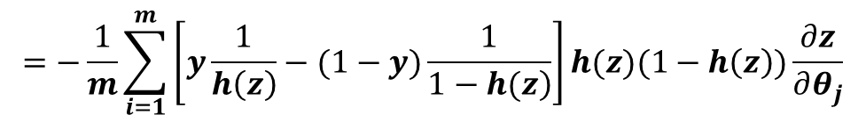
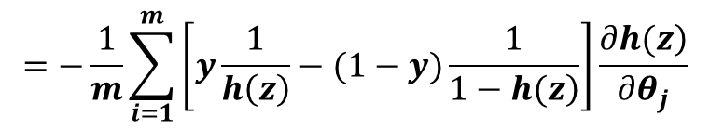
Gradient Descent
$$\frac{∂ h(z)}{∂θ_{j}}=\frac{∂}{∂θ_{j}}\frac{1}{1+e^{−z}}=\frac{∂}{∂z}\frac{1}{1+e^{−z}}\frac{∂z}{∂θ_{j}}=\frac{1}{{\left[1+e^{−z}\right]}^{2}}e^{−z}\frac{∂z}{∂θ_{j}}=\frac{1}{1+e^{−z}}\left[1−\frac{1}{1+e^{−z}}\right]\frac{∂z}{∂θ_{j}}=h(z)(1−h\left(z\right))\frac{∂z}{∂θ_{j}}$$
$$\frac{∂ J\left(θ\right)}{∂θ_{j}}=−\frac{1}{m}\sum_{i=1}^{m}{\left[y\frac{∂ }{∂θ_{j}}log\left(h\left(z\right)\right)+\left(1−y\right)\frac{∂ }{∂θ_{j}}log\left(1−h\left(z\right)\right)\right]}$$
$$=−\frac{1}{m}\sum_{i=1}^{m}{\left[y\frac{1}{h\left(z\right)}−(1−y)\frac{1}{\left.1−h(z\right)}\right]\frac{\left.∂h(z\right)}{∂θ_{j}}}$$
$$=−\frac{1}{m}\sum_{i=1}^{m}{\left[y\frac{1}{h\left(z\right)}−(1−y)\frac{1}{\left.1−h(z\right)}\right]h(z)(1−h\left(z\right))\frac{∂z}{∂θ_{j}}}$$
$$=\frac{1}{m}\sum_{i=1}^{m}{\left[h\left(z\right)−y\right]x_{j}}$$

Slide 13
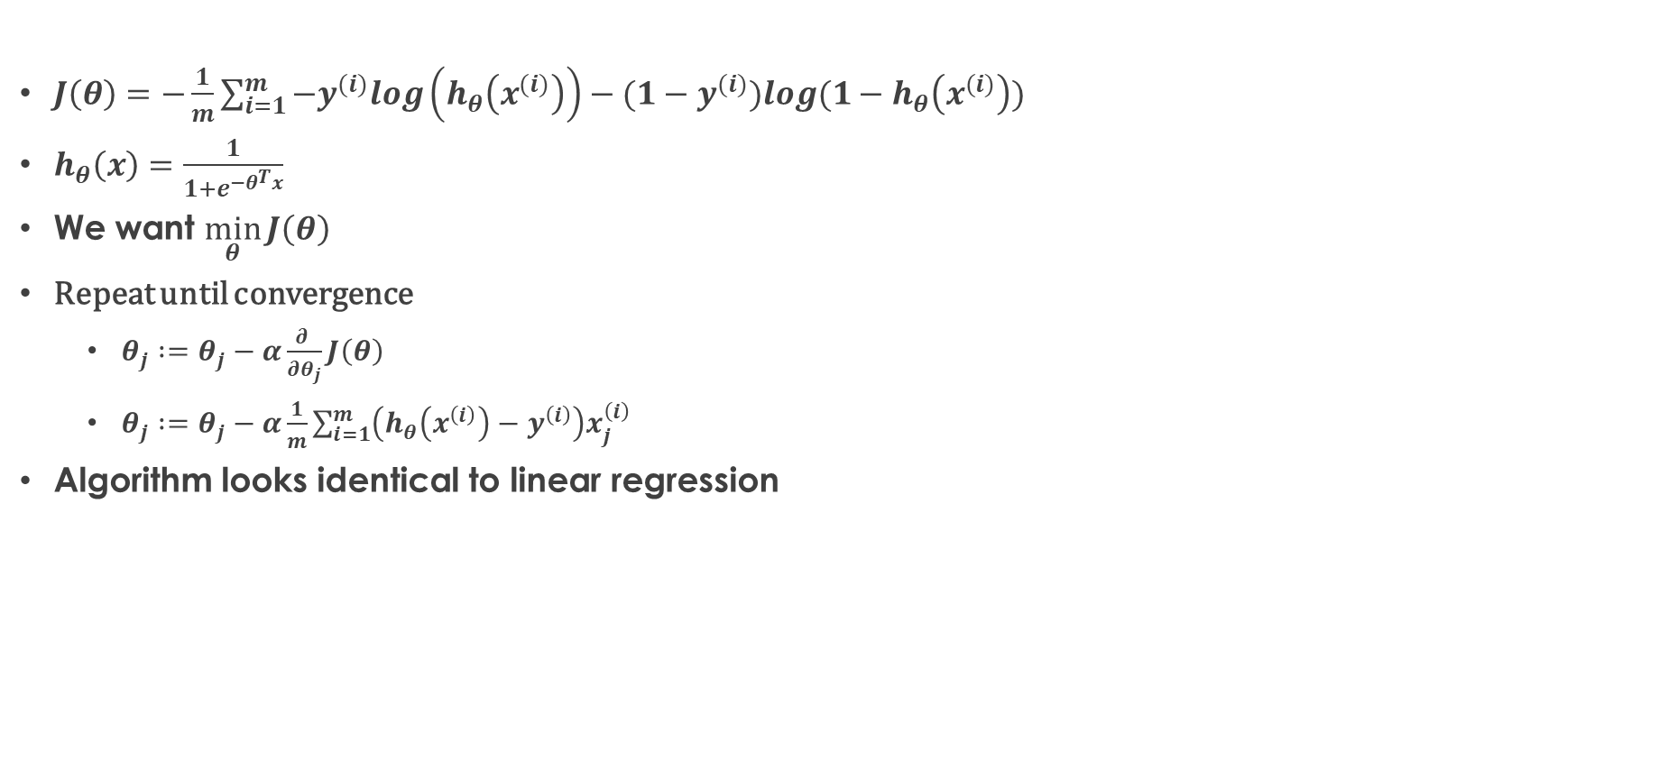
Gradient Descent
$J\left(θ\right)=−\frac{1}{m}\sum_{i=1}^{m}{−y^{(i)}log\left(h_{θ}\left(x^{(i)}\right)\right)−(1−y^{(i)})log(1−h_{θ}\left(x^{(i)}\right))}$
$h_{θ}\left(x\right)=\frac{1}{1+e^{−θ^{T}x}}$
We want $\min_{θ}{J\left(θ\right)}$
Repeat until convergence
$θ_{j} :=θ_{j}−α\frac{∂ }{∂θ_{j}}J\left(θ\right)$
$θ_{j} :=θ_{j}−α\frac{1}{m}\sum_{i=1}^{m}{\left(h_{θ}\left(x^{\left(i\right)}\right)−y^{\left(i\right)}\right)x_{j}^{\left(i\right)}}$
Algorithm looks identical to linear regression

Slide 14
Stochastic Gradient Descent (SGD)
A simple yet very efficient approach to discriminative learning of linear classifiers under convex loss functions such as (linear) Support Vector Machines and Logistic Regression
SGD has been successfully applied to large-scale and sparse machine learning problems often encountered in text classification and natural language processing
The advantages of Stochastic Gradient Descent are:
Efficiency
Ease of implementation (lots of opportunities for code tuning)
The disadvantages of Stochastic Gradient Descent include:
SGD requires a number of hyperparameters such as the regularization parameter and the number of iterations
SGD is sensitive to feature scaling

Slide 15
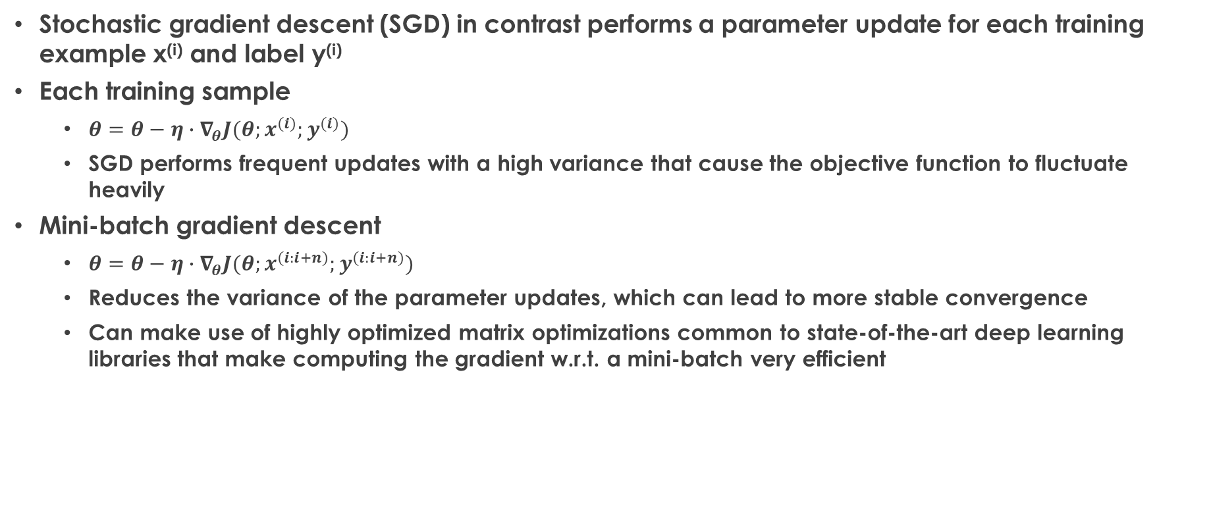
Stochastic Gradient Descent (SGD)
Stochastic gradient descent (SGD) in contrast performs a parameter update for each training example x^{(i)} and label y^{(i)}
Each training sample
$θ=θ−η∙∇_{θ}J(θ;x^{(i)};y^{(i)})$
SGD performs frequent updates with a high variance that cause the objective function to fluctuate heavily
Mini-batch gradient descent
$θ=θ−η∙∇_{θ}J(θ;x^{(i:i+n)};y^{(i:i+n)})$
Reduces the variance of the parameter updates, which can lead to more stable convergence
Can make use of highly optimized matrix optimizations common to state-of-the-art deep learning libraries that make computing the gradient w.r.t. a mini-batch very efficient

Slide 16
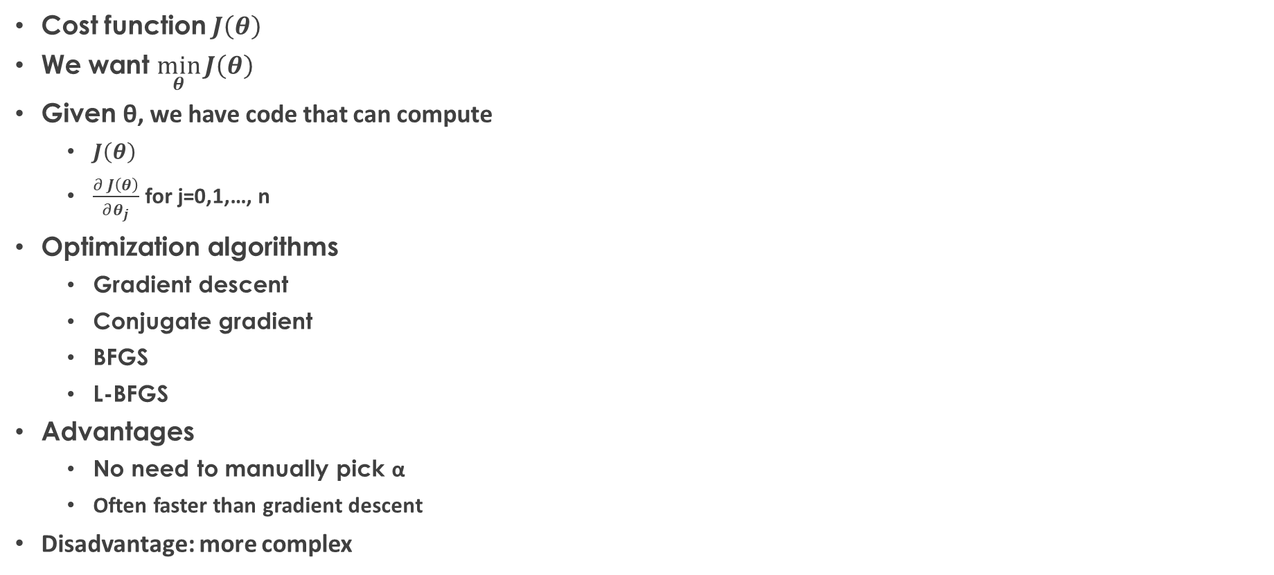
Advanced Optimization
Cost function $J\left(θ\right)$
We want $\min_{θ}{J\left(θ\right)}$
Given θ, we have code that can compute
$J\left(θ\right)$
$\frac{∂ J\left(θ\right)}{∂θ_{j}}$ for j=0,1,…, n
Optimization algorithms
Gradient descent
Conjugate gradient
BFGS
L-BFGS
Advantages
No need to manually pick α
Often faster than gradient descent
Disadvantage: more complex

Slide 17
Multiclass Classification
Email tagging: Family, Friends, Hobby, Work
Medical conditions: normal, cold, flu
Weather: clear, cloudy, rain, snow, sunny
Binary classification
Multiclass classification
x₂
x₂
x₁
x₁

Slide 18

One-vs-All (One-vs-Rest)
x₂
x₁
x₂
x₂
x₁
x₂
x₁
x₁
$$h_{θ}^{(i)}\left(x\right)=P\left(y=i|x;θ\right) (i=1, 2, 3)$$

Slide 19

One-vs-All
Train a logistic regression classifier $h_{θ}^{(i)}\left(x\right)$ for each class i to predict the probability that y=i
To make a prediction for a new input x, pick class i that maximizes $\max_{θ}{h_{θ}^{(i)}\left(x\right)}$

Slide 20


Confusion Matrix
Predicted Class
 | Class 0 | Class 1
Class 0 | True Negatives (TN) | False Positive (FP)
Class 1 | False Negative (FN) | True Positive (TP)
Actual Class
True positive rate: $\frac{TP}{TP+FN}$
False positive rate: $\frac{FP}{FP+TN}$

Slide 21
Question?
Insert Image

